Slide 1
Event driven architecture

Slide 2
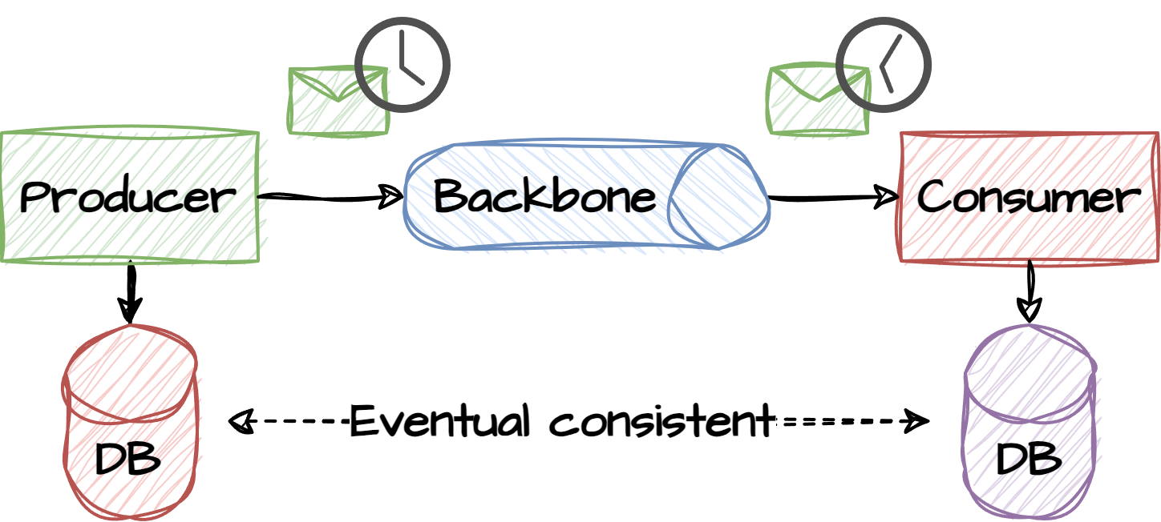
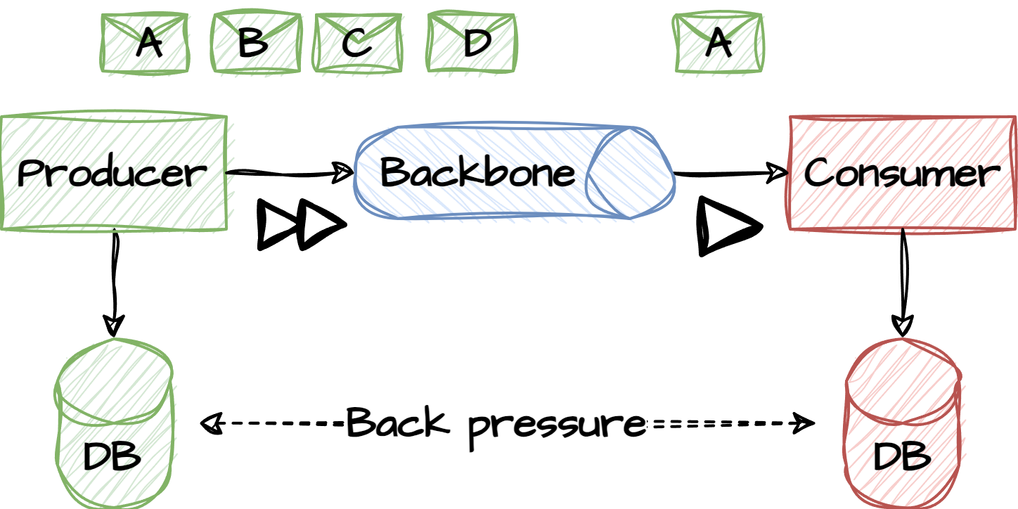
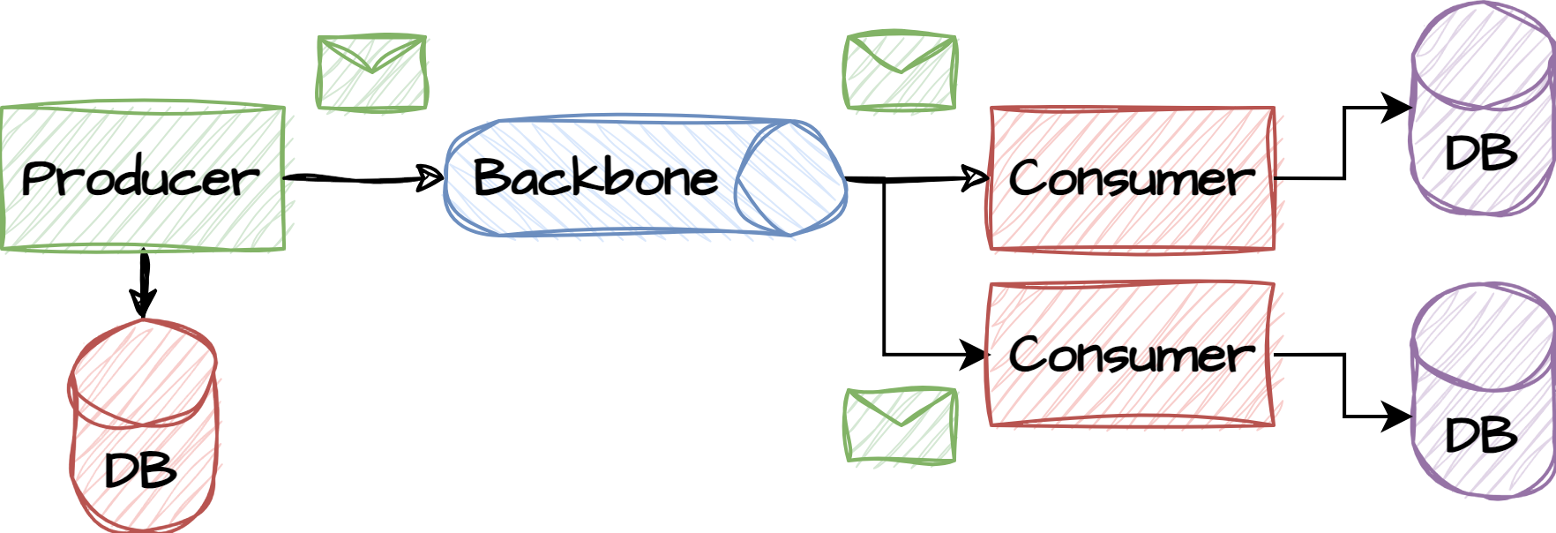
EDA overview
Event-driven architecture (EDA) is a software design pattern that enables an organization to detect “events” or important business moments (such as a transaction, site visit etc) and act on them in real time or near real time. This pattern replaces the traditional “request/response” architecture where services would have to wait for a reply before moving on to the next task. The synchronous communication approach does not scale well and introduces blocking code and increases risks of failures.
In EDA, events are emitted by an event emitter and broadcasted to any number of listeners through an event backbone. The event emitter has no knowledge of whom may consume the event. Event listeners are also completely decoupled from the event emitters and may emit new events onto the backbone as a response to the event. The decoupling of producers and consumers adds several benefits to the system design. The decoupling allows producers and consumers to produce/consume and different speed rates, allow new consumers to be added seamlessly and replay historic events.
The downside is added complexity when introducing an event pipeline in between components, observability issues and versioning of data.

Slide 3
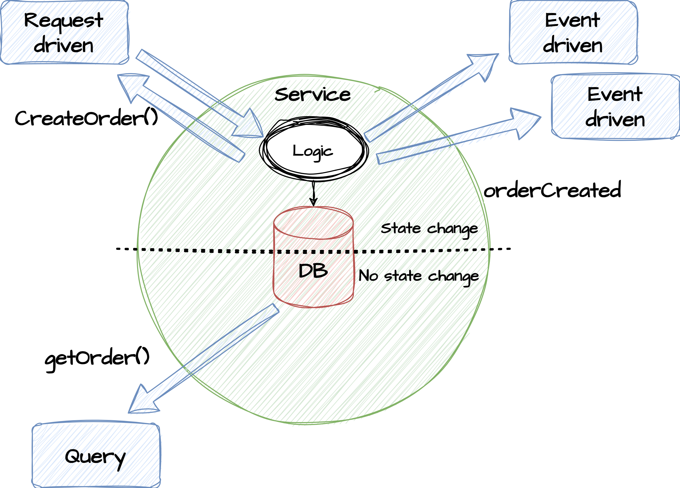
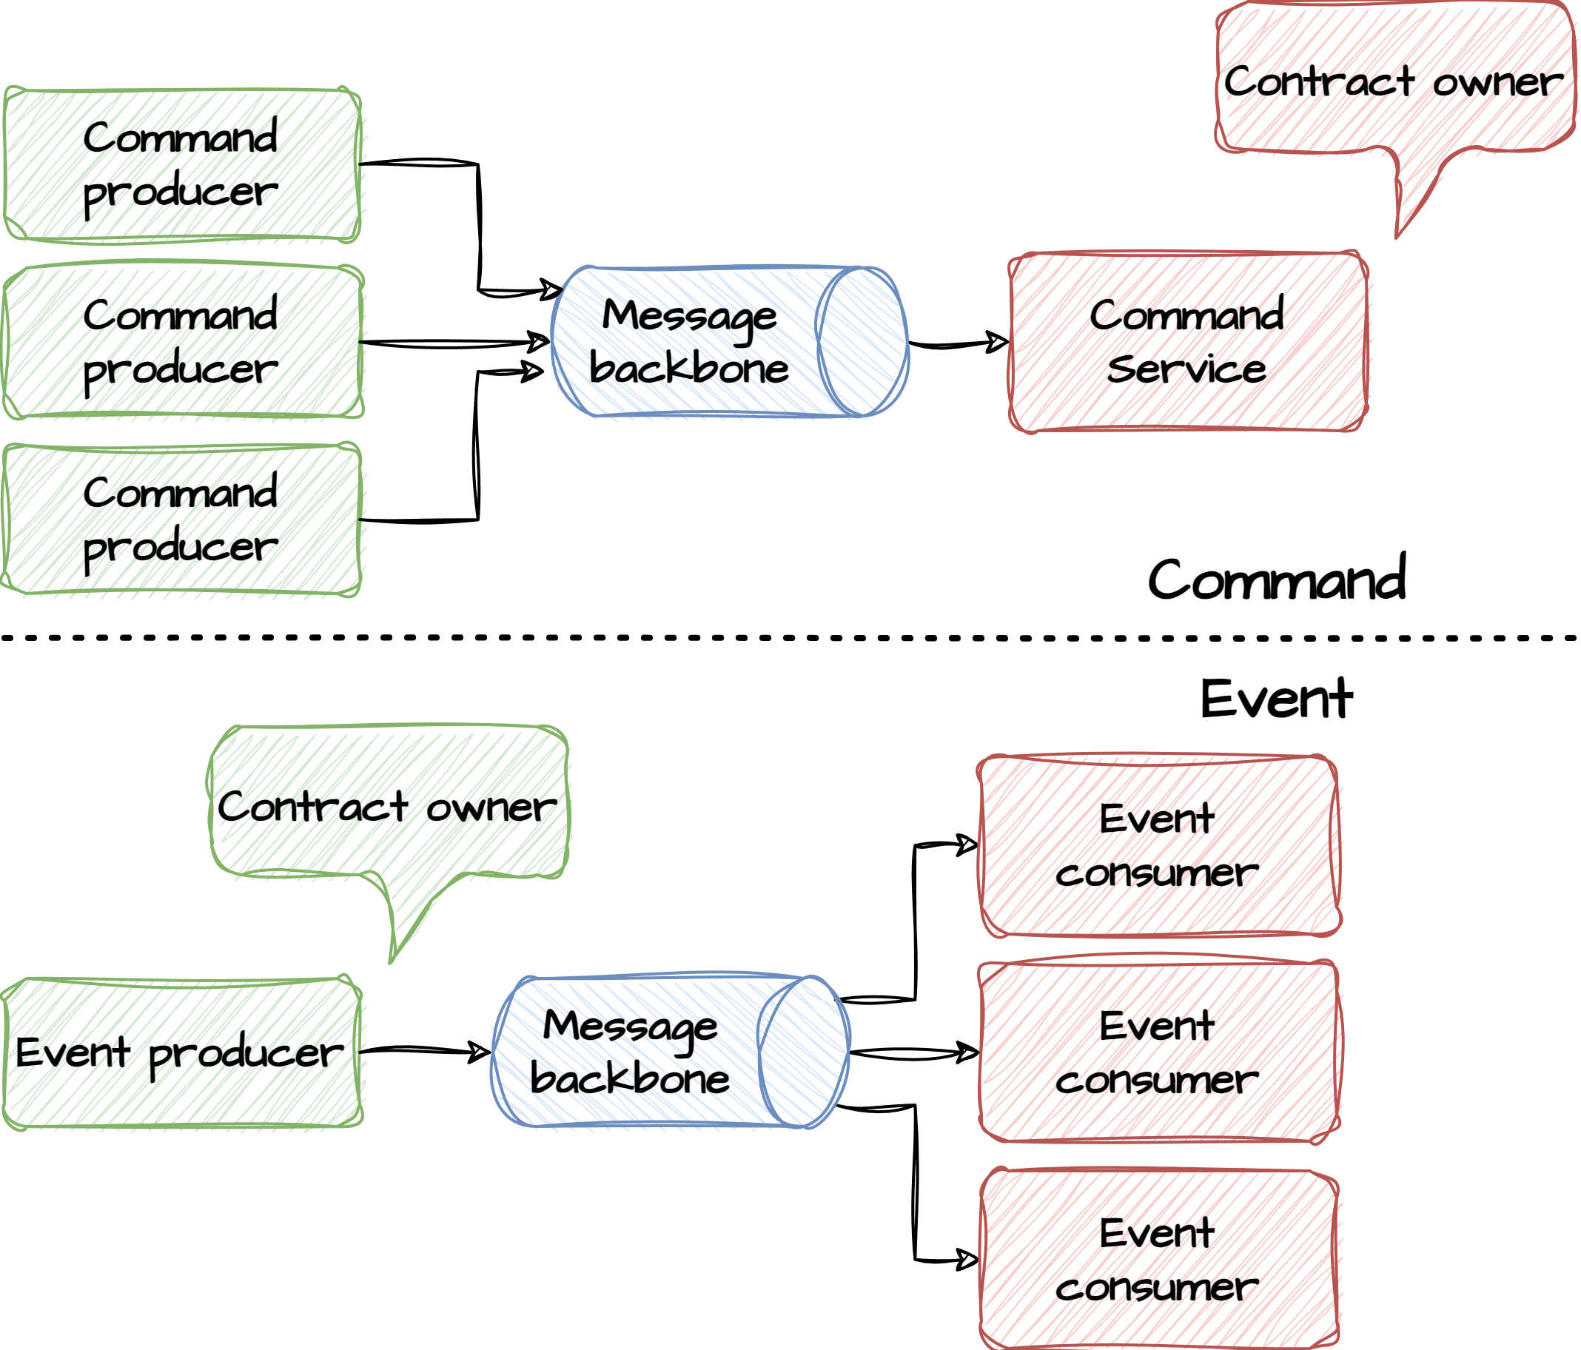
Events, Commands and Queries
Events
Something happened (provide identity + context)
Zero or many consumers (completely decoupled)
Single producer (owner of the event and its data)
Owned by producer
Commands
Invoke behavior (target a specific recipient)
Single consumer (consumer executes the command)
Multiple senders (Anyone can send a command)
Owned by consumer
Queries
Peer-to-peer. Typically in the form of HTTP calls
No side-effects (state changes) in the service.
Read-only and typically backed by a data-store

Slide 4
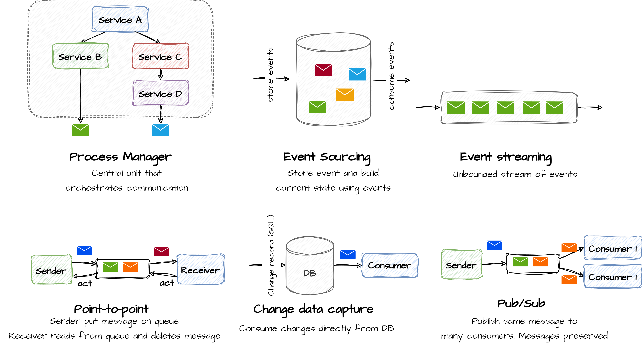
Event communication patterns

Slide 5
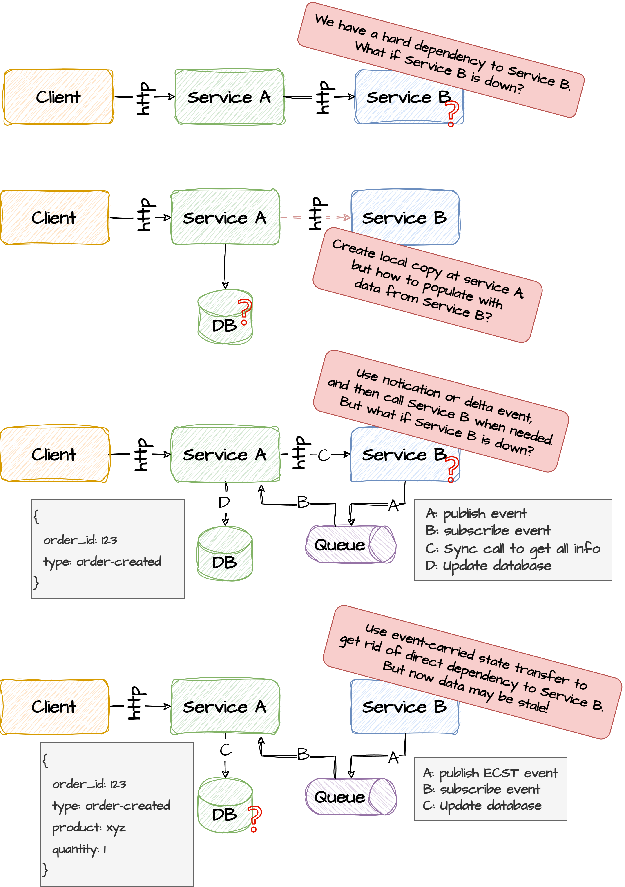
Events
Events is about something that has happened. They are ordered and immutable and once published cannot be changed or re-ordered. Multiple consumers can subscribe to these events. Event may carry more (fact) or less (delta) information which is a trade-off between high-coupling due to additional lookups (consistency) or risk of carrying stale data but with no additional lookup (availability).
Events should only carry data that it owns. To prevent model sprawl, its the responsibility of the consumer to consume data from other referenced domains.
Delta event
Only communicate changes (deltas, provide context for the event past tense)
Medium risk of breaking data contract
Medium coupling
Internal and External events (for DDD)
Internal (domain) events are used inside the domain whereas external (integration) events are used between domains
Delta event
Event-carried state transfer (fact)
Rich events so no need to fetch additional data fro owner.
Risk of data becomming stale and breaking data contracts
Low coupling
Notification event
Small risk of breaking data contract
Low coupling
Minimal payload, expect consumers to fetch data at the owner
Fat event

Slide 6
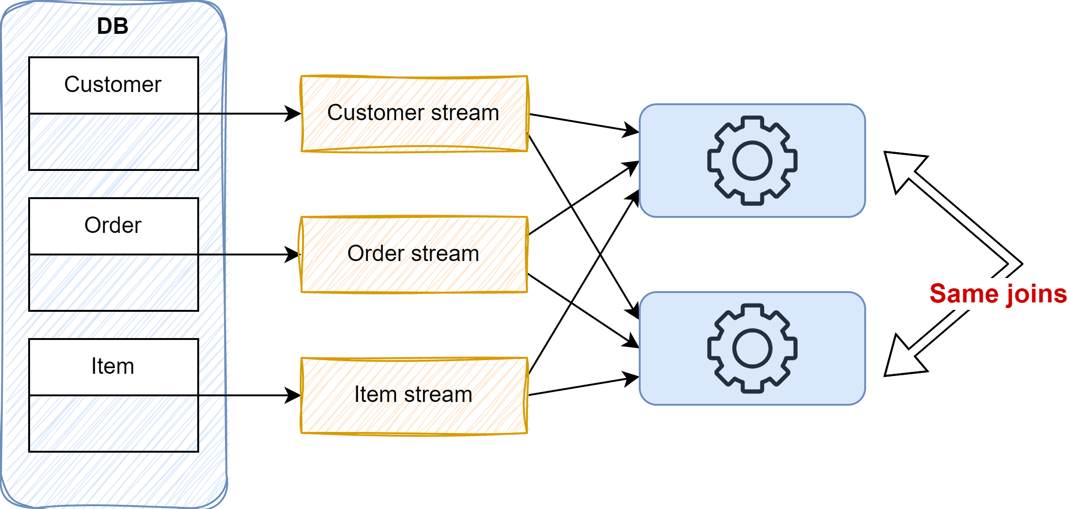
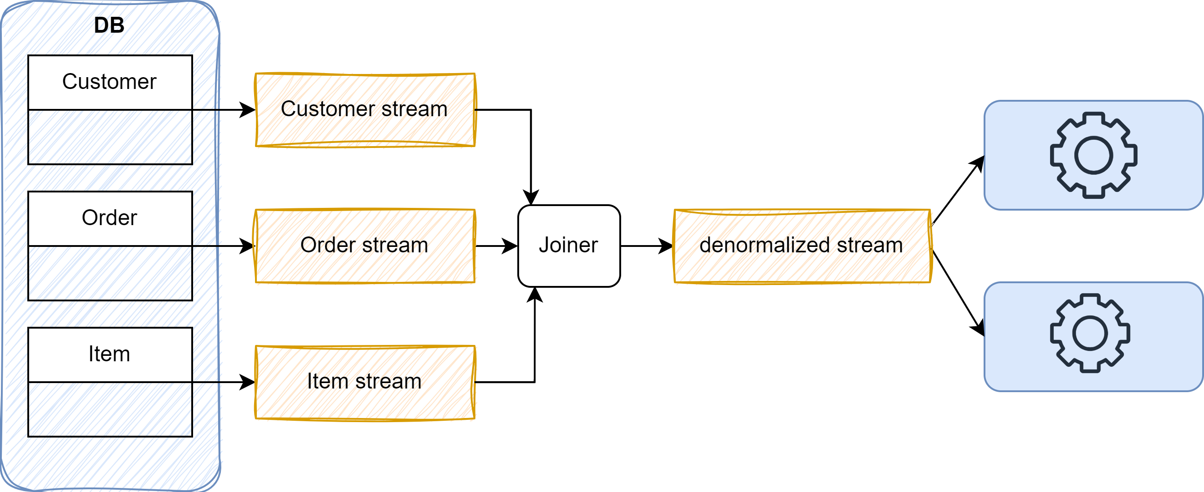
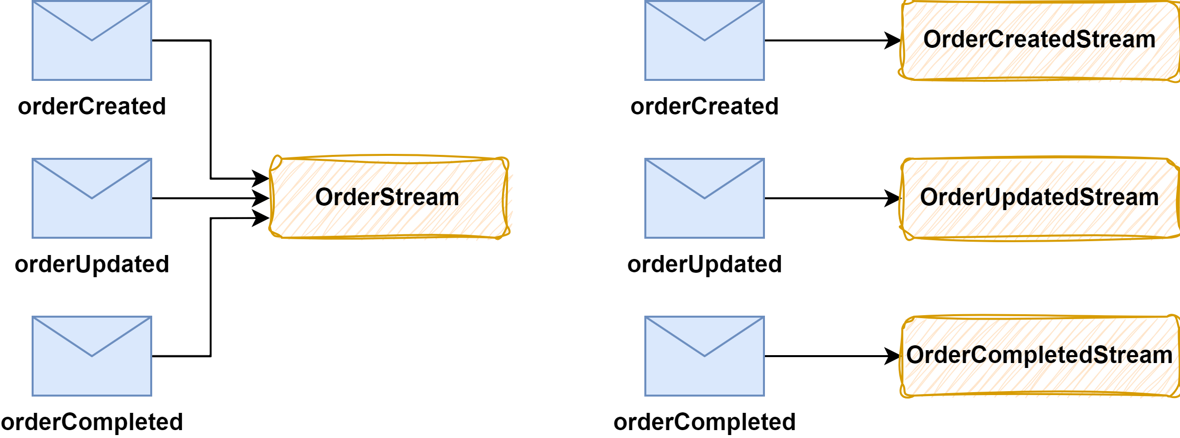
Designing events
{
type: customerUpdated
customerId: xyz
name: John Doe
}
{
customerId: xyz
name: John Foo
dateOfBirth: 010101
email: jf@mail.com
}
High coupling to datasource
{
type: customerUpdated
customerId: xyz
before: {
name: John Foo
}
after: {
name: John Doe
}
}
Fact vs Delta Event types
Normalization vs Denormalization
Single vs Multiple Event types pr topic
De-normalization
One topic pr event
Shared topic
CDC
Could also be trans outbox
Order of event types is lost

Slide 7
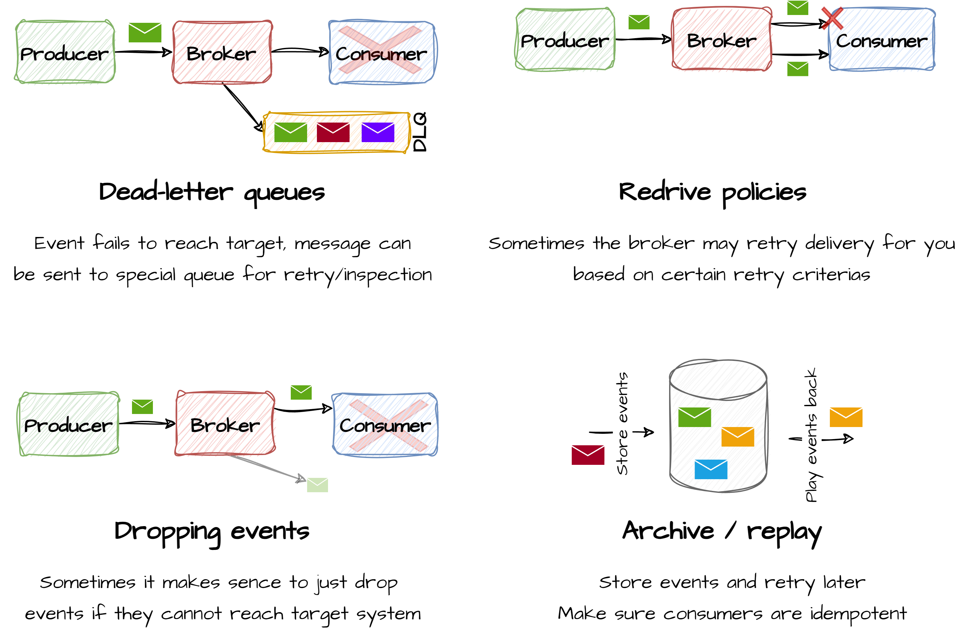
Event delivery failures

Slide 8
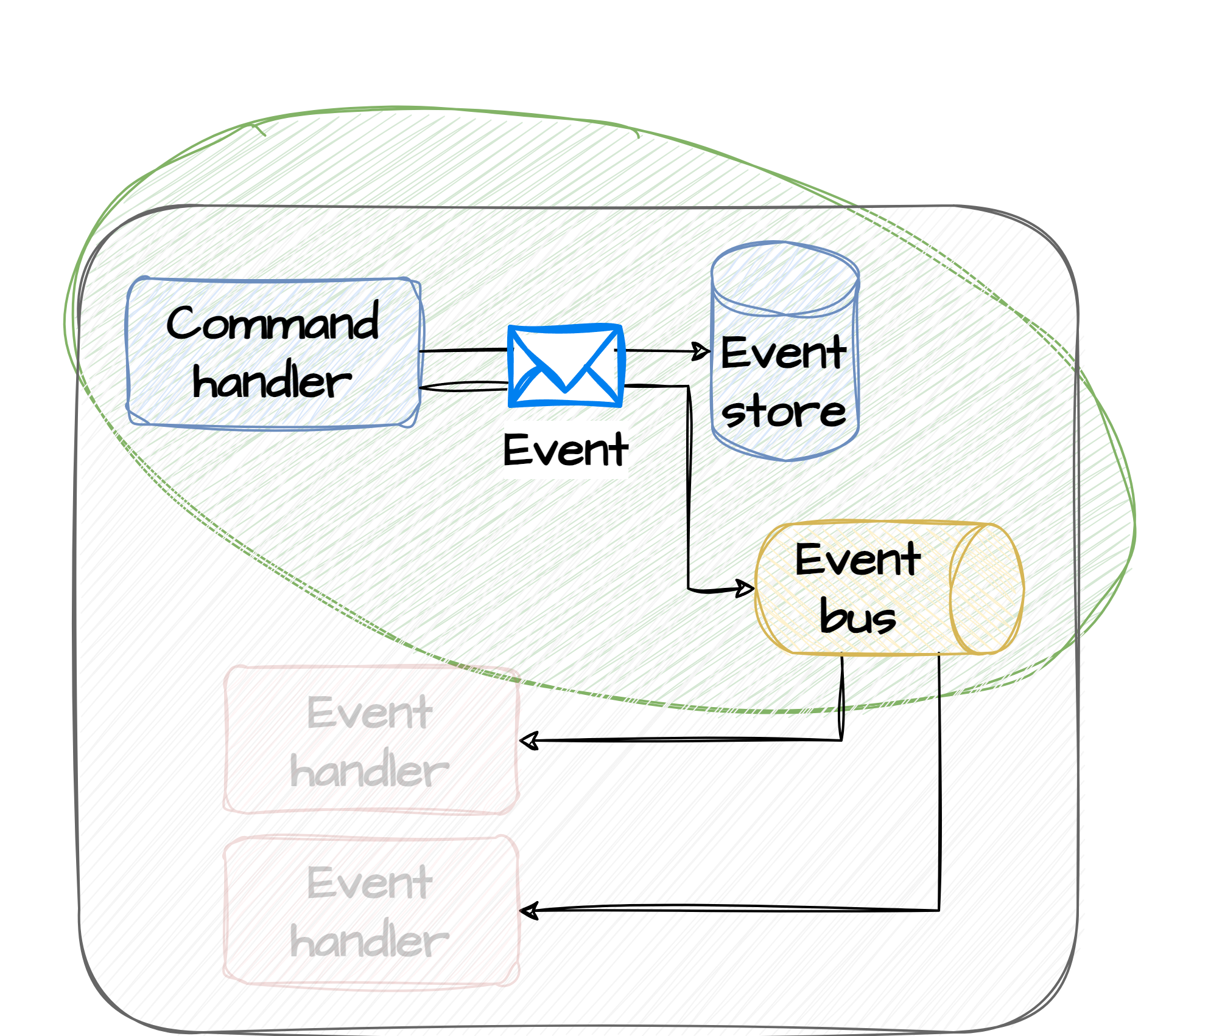
Event Sourcing
Event sourcing is a way of modeling and persisting events (typically delta events) as a series of immutable and ordered events rather than focusing on the current state of the entity behind the event.
Events are stored in an event store which is local to the service (bounded context) that it lives in. Events in the event store can be replayed and thereby used for state reconstruction or used for auditing or debugging purposes.
To optimize replay and state reconstruction sometimes snapshots are made. When recreating state, you find the latest snapshot and apply all changes made since then.

Slide 9
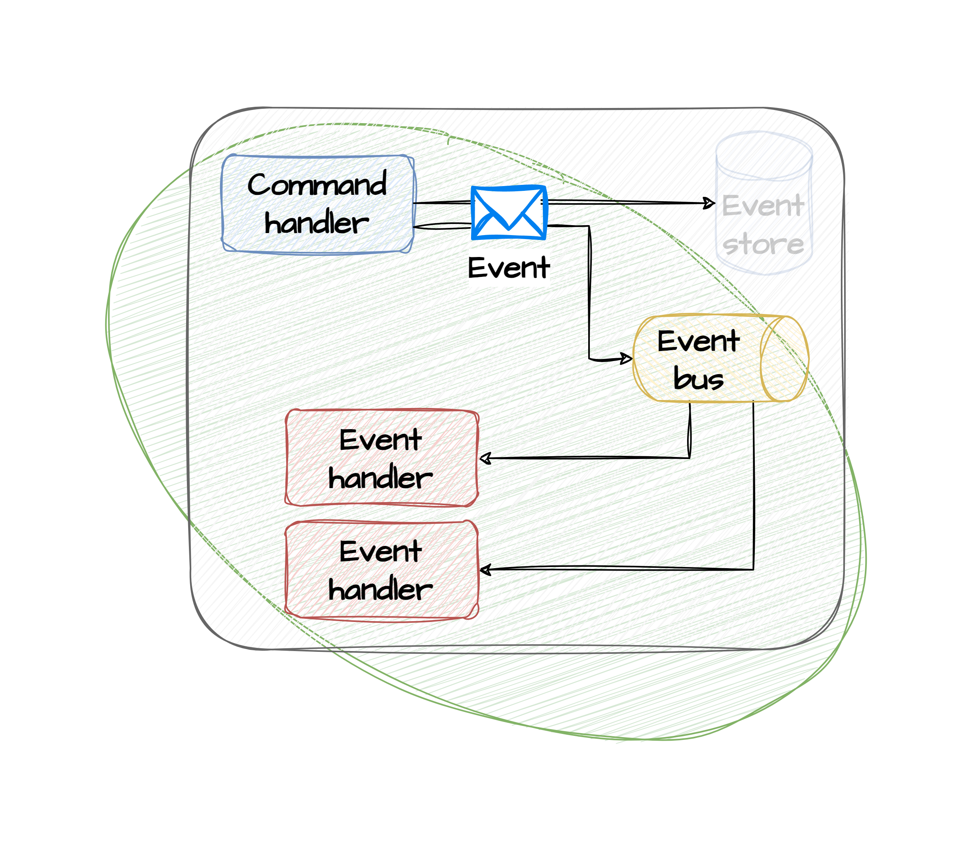
Event Streaming
Event streaming is an ordered, unbounded sequence of immutable events flowing from producers to consumers through an event backbone with an at-least-once delivery guarantee. Whenever a service or bounded context makes changes to an entity that it owns, this can be published as an event on an event backbone. The event may carry context depending on the design. Event streaming uses a pub-sub approach to enable decoupled communication between systems. Consumers subscribe to a topic/channel on the event pipeline, and producers produce events to these topics/channels. Services may act as both consumers and producers of events. The pub-sub design decouples the producers and consumers, making it easier to scale each part of the system individually.

Slide 10
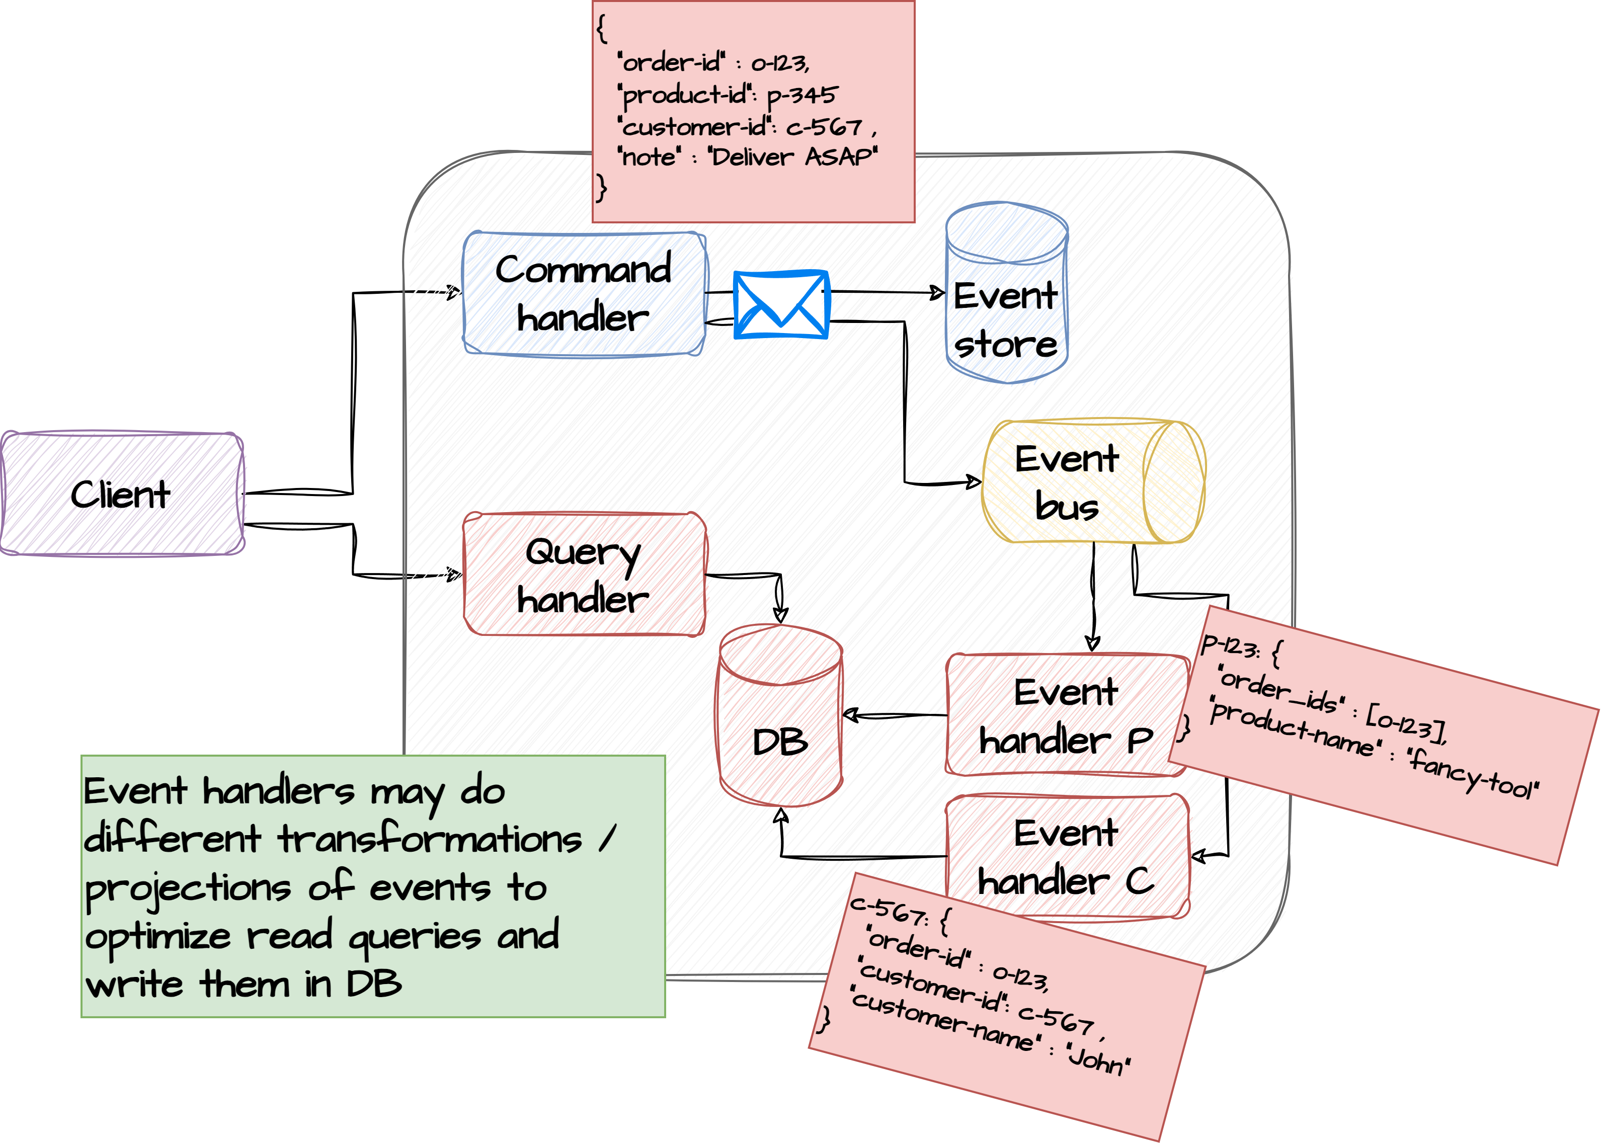
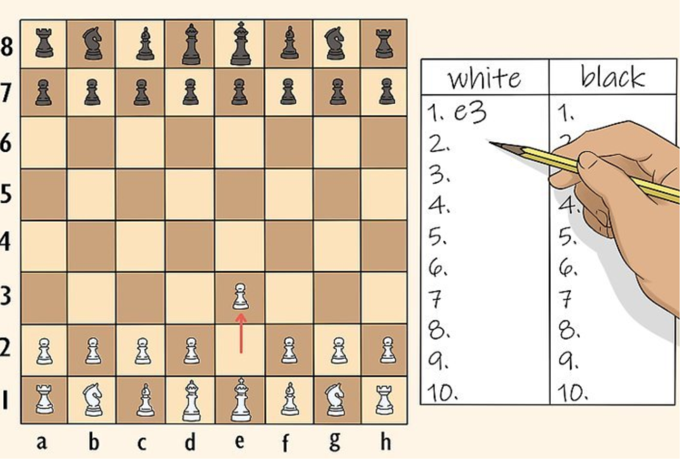
Event Projection - CQRS
CQRS, which stands for Command Query Responsibility Segregation, is an architectural pattern used to separate the concerns of handling commands (write operations) and queries (read operations) within an application.
By separating read/write operations this way you can optimize each part independently. Read operations typically have different forms and transformers (event handlers) can project the same write operations into different projections that are read optimized.
Advantages:
Scalability – Separate read/write operations
Flexibility – Create different projections
Disadvantages:
Complexity in code
Eventual consistency

Slide 11
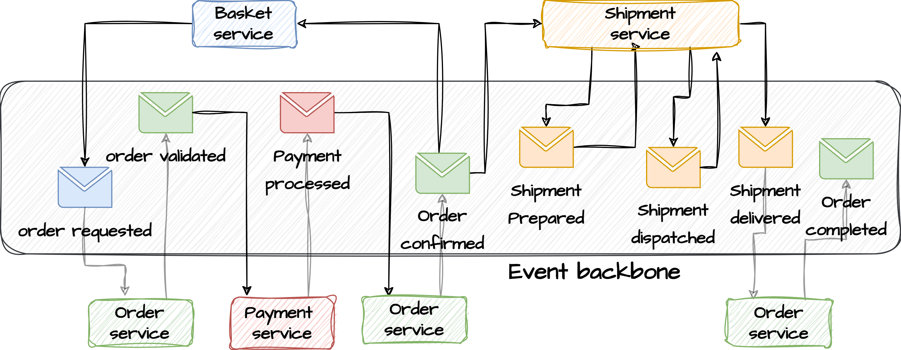
EDA at a larger scale
Looks simple – but is it really?

Slide 12
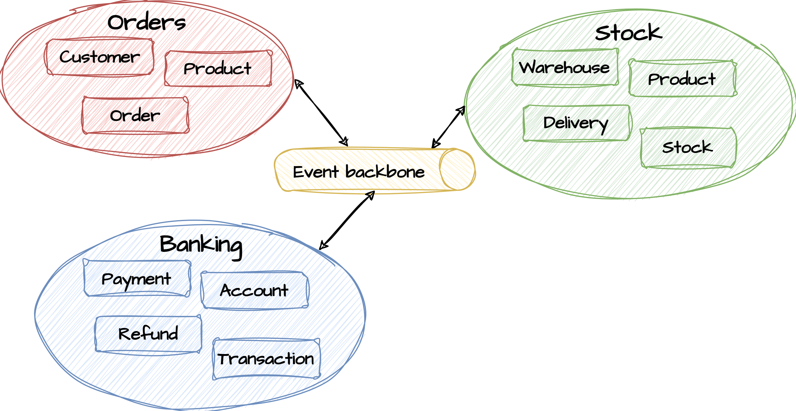
DDD and Bounded contexts
DDD (domain driven development) is about technical- and domain model alignment so that domain experts and technical team members working together can communicate about the model in an unambiguous way.
In DDD, bounded contexts help to establish clear boundaries between different parts of the system by grouping related domain entities. This allows for better separation of work as smaller teams can focus on sub domains. Inside a boundary, the model must be consistent and coherent, meaning that the entities must be inter-related and dependent on each other. Messages sent between services inside a bounded context is referred to as domain events.
The same entity name may occur within different bounded contexts (like Product in Orders and Stock).
A public language (model) needs to be specified when communicating between bounded contexts.
Events sent between bounded context are referred to as integration events. Sometimes translations to/from integration events must happen before sending to the backbone or receiving from the backbone if the producing or consuming bounded context is not aware of integration event language.

Slide 13
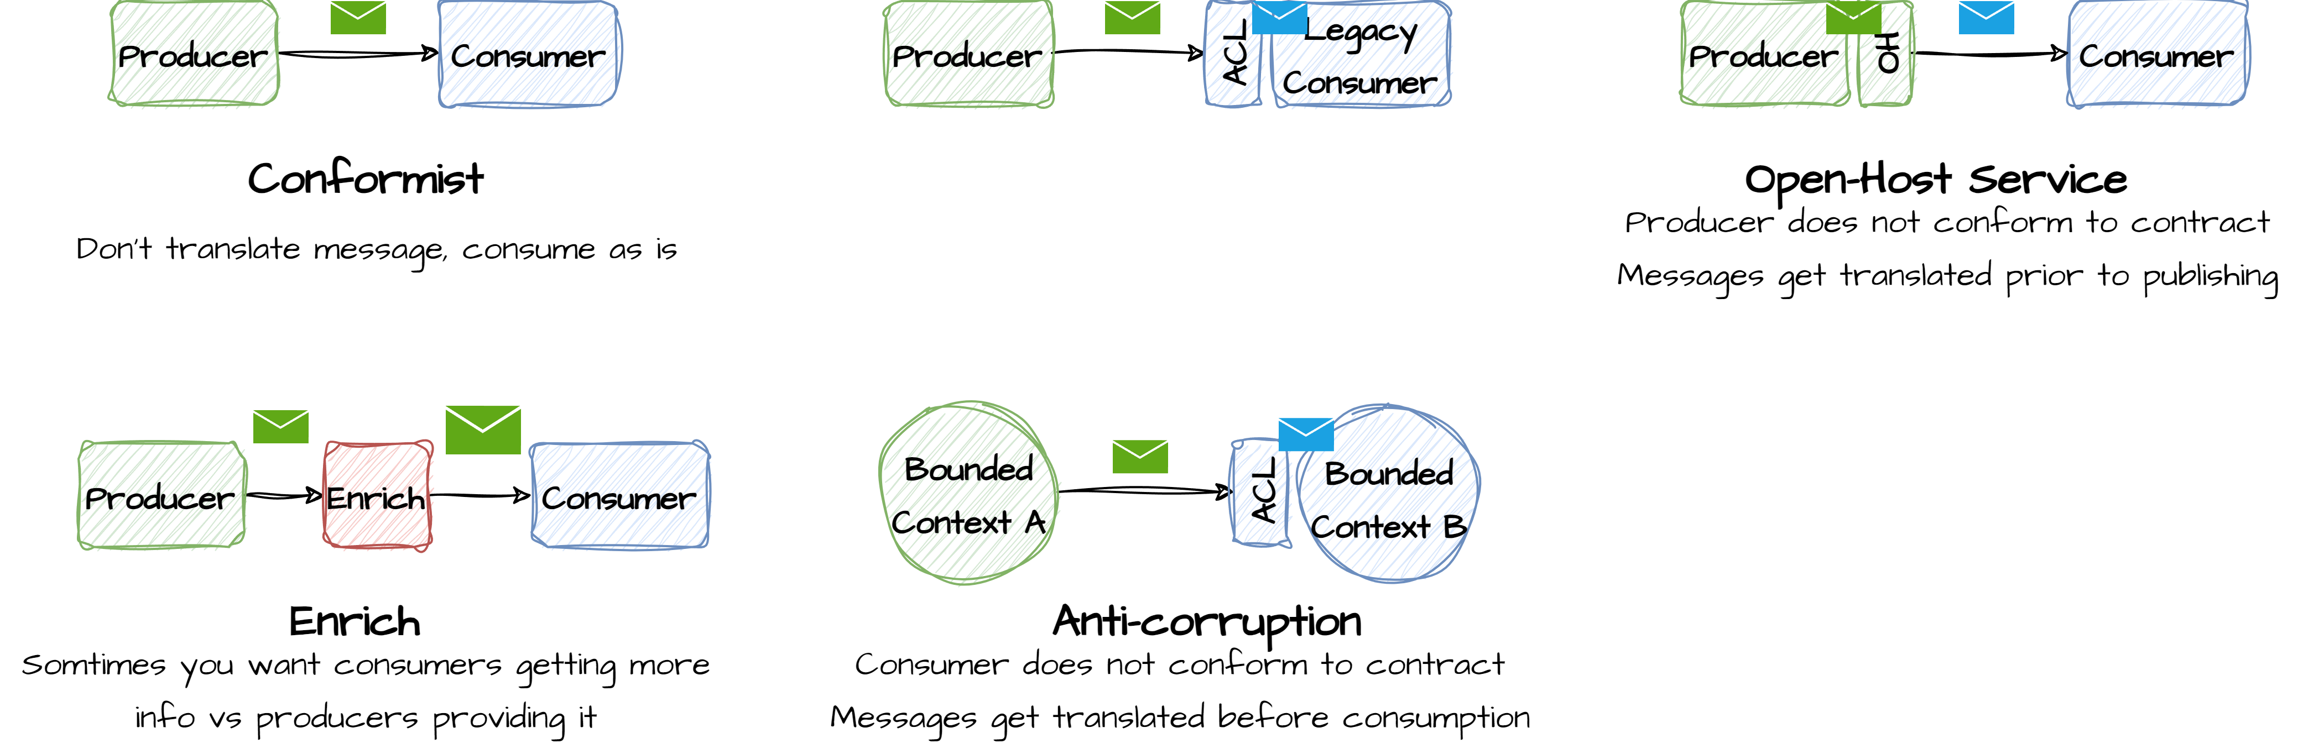
Messages between bounded context

